Slide 1
FinanceStory
“Our Journey Together”
Group E10:
Ryan | Keith | Jovan | Abishek | Ethan

Slide 2
Table of Contents
01
02
03
04
05
Proposed Solution
Live Demo
Technical Implementation
FinanceStory Web Application
Tools & Considerations
Road Map
Q & A
Envisioning the Future

Slide 3
Proposed
Solution
01

Slide 4
Concept
Gamification
Sustainability
Enhance Client & Bankers Experience
Fun & Engaging
Incentives
Co-op with friends & family

Slide 5




Features
Destination
Quest
Shop
Bulletin Board
Enable Clients to set Goals
Partitions Savings Account to achieve set Goals
Guide & Educate Clients
Gives Gold & EXP
Purchase Rewards
Promote other Products & Services
Provide useful Articles & Reports
Notes:
Destination enable clients to set their own financial goal, for example if a client wishes to purchase a Jay Chou Concert Ticket he can do so by setting a new desitionation & what destination does is, it creates a partition in client’s savings account & gives them an indication on how much they have to set aside to reach that destination.
Just like every MMORPG games, an adventurer have to equip themselves in order to reach their next destination. They can do so in our Shop feature where they can redeem rewards using Gold that they have earned. They would be able to purchase bank Products & Services.

Slide 6
Benefits
Gain new Business Opportunities
Boost Clients’ Knowledge
Increase Bankers’ Job Satisfaction
Increase Cash in Bank
Improve Clients’ Experience

Slide 7
Live
Demo
02

Slide 8
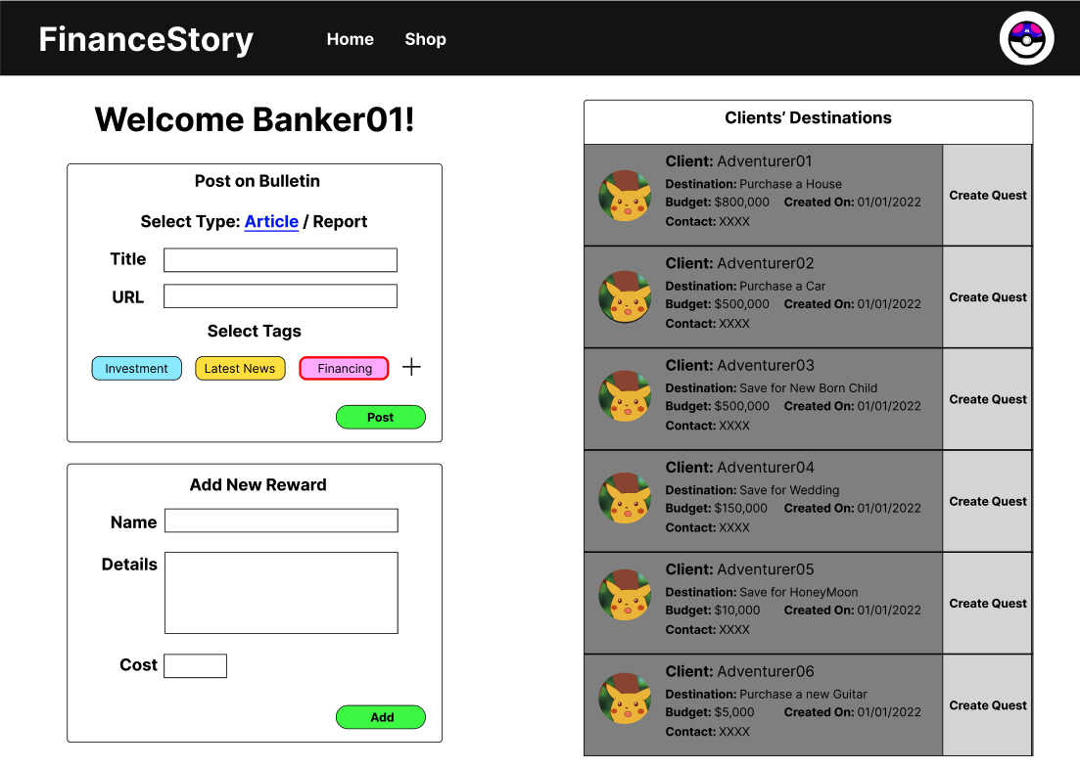

Slide 9
Technical
Implementation
03

Slide 10






Front-End
Back-End
Database

Slide 11

Cloud Service Provider

Slide 12
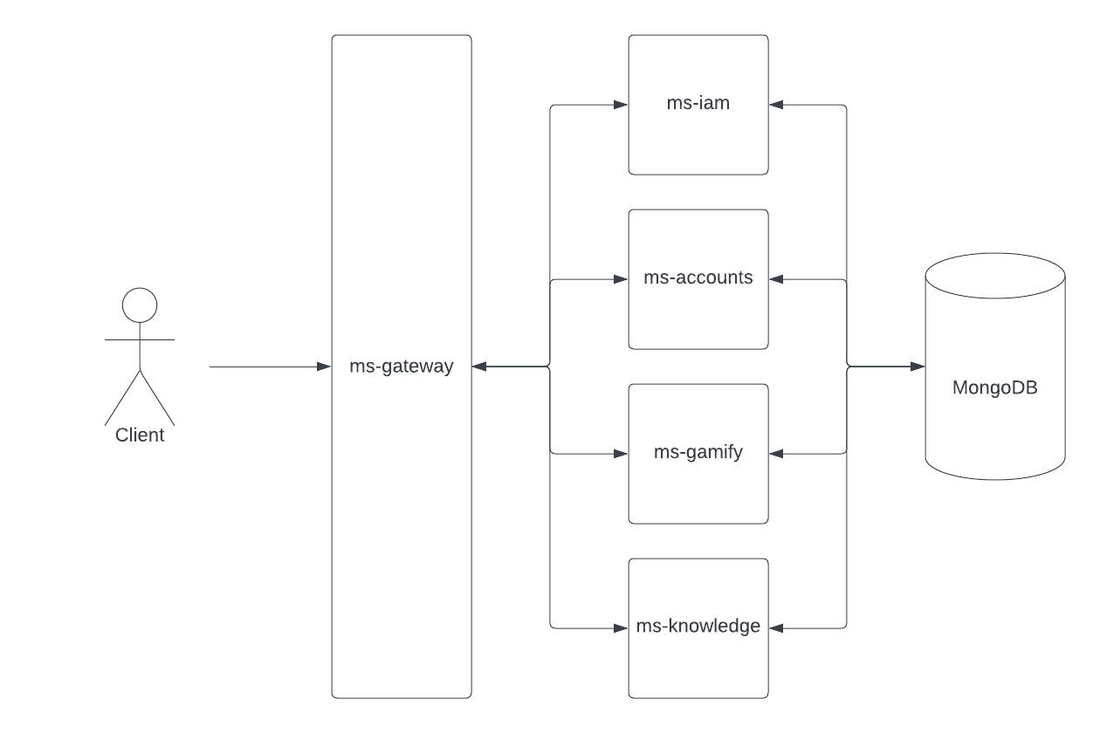
Microservice Architecture

Slide 13

Road
Map
04

Slide 14
Envisioned Road Map
FinanceStory Mobile Version
V1
V2
V3
V4
New Chapter
Co-Op
Portfolio Integration
Guild
Deploy working Application
Friends & Family can share a common Destination
Party Quest
Parents can Issue Quests to Children
Integrate Clients’ existing Portfolio
Flag out high risk Investors
Destination for Investment
Bank can create Guilds based on interest
Clients can apply to join Guilds (approved by bankers)
Guild Venture

Slide 15
Q & A
05

Slide 16
Thank you!
“Let us Journey Together & Create our Story”
By: Group E10
Ryan | Keith | Jovan | Abishek | Ethan

